Slide 1
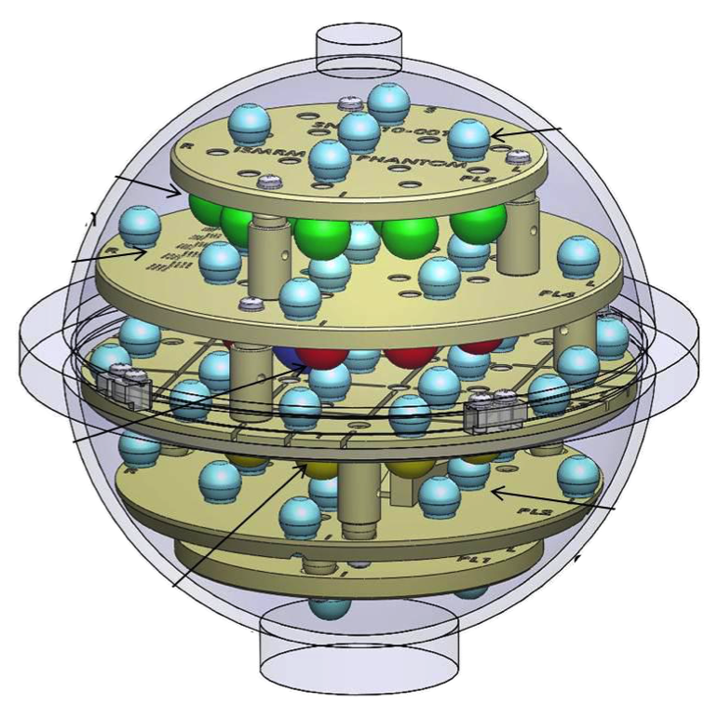
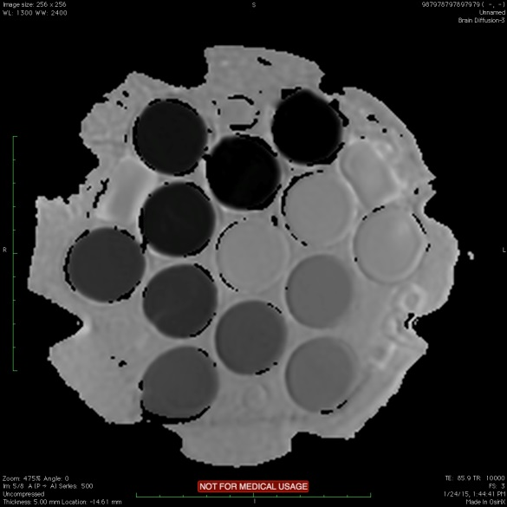
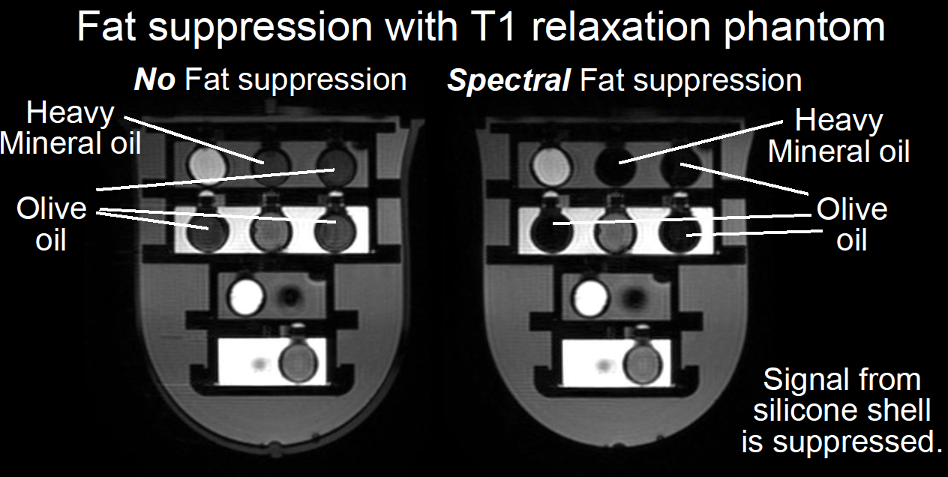
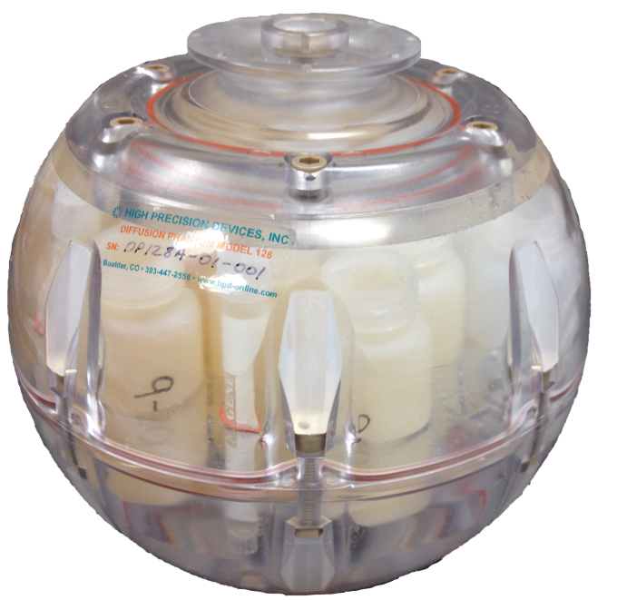
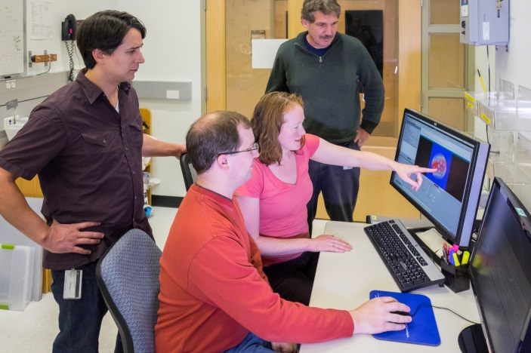
Biomagnetic Imaging Standards: Current Phantoms
NIST/ISMRM system phantom
NIST/UCSF/NCI system phantom
NIST/RSNA/NCI diffusion phantom
T₁ array
Fiducial
array
Wide range of diffusion
Resolution
inset
T₂ array
Slice
profile
inset
Proton density
array
NIST group Michael Boss, Karl Stupic, Katy Keenan, and Stephen Russek

Slide 2
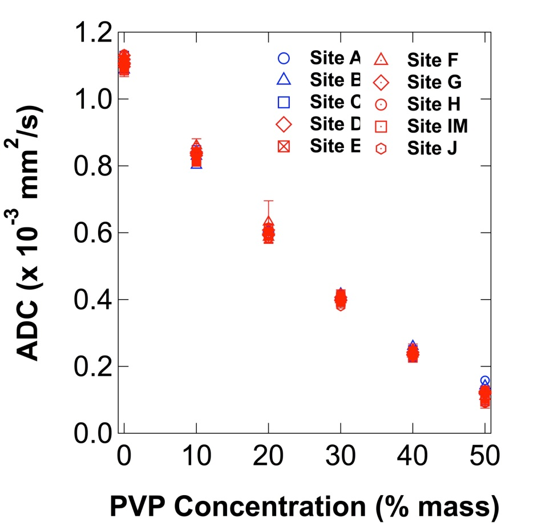
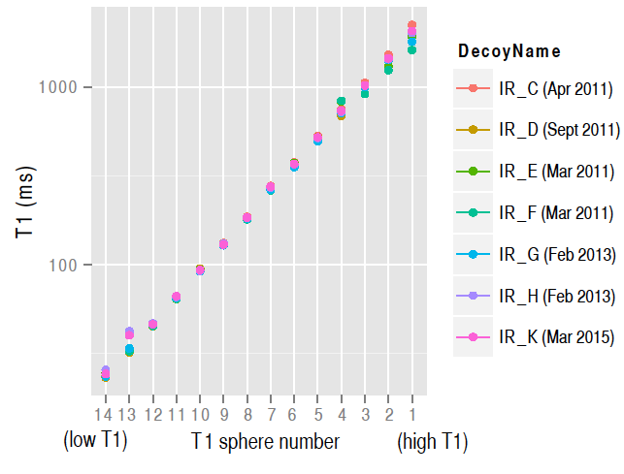

NIST’s Role in MRI: to provide
Long-term support of MRI phantoms,
SI-traceability
Connection of MRI measurements to primary physical measurements
Understand errors and variability

